Slide 1


CREPT – Compact Relativistic Electron Proton Telescope
Ashley Jones
1 August 2012

Slide 2
Introduction
Background information
Van Allen Radiation Belts
Particle motion
Microbursts
What I am working on
Instrument building
Simulations
Calibrations
Summary

Slide 3
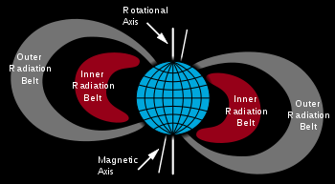
Van Allen Radiation Belts
The belts consist of ~1-10 MeV electrons and protons trapped in Earth’s magnetic field
Earliest models strictly showed an inner and outer zone, but by 1990, scientists detected injection of outer belt electrons and solar energetic protons to a slot region between the belts
These trapped regions can last for years
The outer zone is dynamic and electron lifetimes range from minutes to years
The inner zone is more stable, lifetimes lasting > 100 days
Notes:
Outer zone, L≥3
Inner zone, L<2, largely cosmic ray albedo neutron decay and solar energetic protons
Electrons exist in both zones

Slide 4
Particle motion
In the Earth’s trapped field, there are three degrees of motions
Latitudinal motion happens on the scale of seconds
Gyroscopic motion is on the scale of milliseconds
Longitudinal motion occurs on the scale of minutes
Pitch angle: angle between the direction of the magnetic field and spiral trajectory
Trapped particles bounce back and forth near the poles, but if the pitch angle is small enough, the particle interacts with the atmosphere. This is called precipitation.

Slide 5
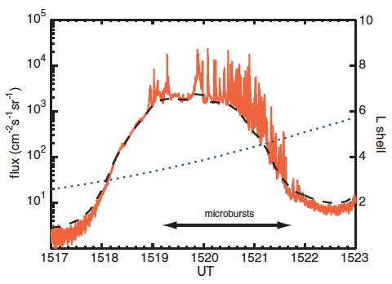
Microbursts
Short, intense bursts of precipitation (tens of msec)
Significant loss mechanism for electrons on the outer zone
Loss time scale ~1 day
Observed on dayside
Notes:
Dotted line the flux you would expect to see, peaks are bursts
Flux content enough to
deplete outer belt

Slide 6
Studying microbursts in more detail can tell us what causes these sudden flux changes
I have been helping to build a detector to detect these microbursts using a stack of solid state detectors used as a particle telescope

Slide 7
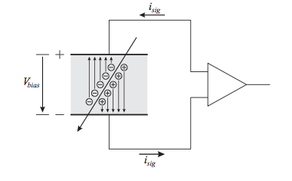
Solid-State Detector
Incoming particle creates electron-hole pairs
Applied electric field sweeps charge, inducing a current
Signal charge is proportional to energy lost

Slide 8
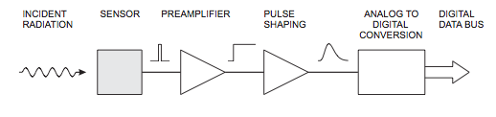
Detector overview
Sensor – energy to signal
Preamplifier – amplifies the signal so it is measurable
Pulse shaper – improve signal to noise ratio
ADC – converts smooth pulse amplitude to discrete steps for energy output

Slide 9
Geant simulations
When a particle travels through a stack of detectors, it deposits some amount of energy in each detector (the amount is dependent on the total energy of the particle)
My mentor created simulations of 100000 particles going through the telescope
Using these simulations, I could see how much energy was deposited in each detector as well as the total energy of the particle

Slide 10
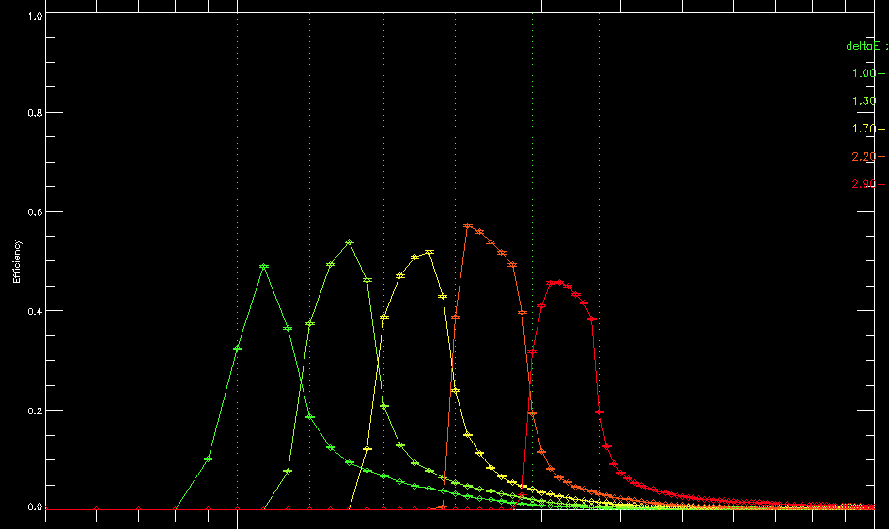
I created equations that would allow us to label an incoming particle as being within a certain range of energy based on how much energy was deposited in each detector
Eg, if a particle deposits greater than .5 MeV in detector 1 and less than .3 MeV in detector 2, it likely has total energy 1-1.3 MeV
Efficiency Charti

Slide 11
Detector Calibration
IV curves – Varying voltages were applied to the detector. A resistor of known resistance was attached to the detector output, and the current was measured across the resistor. Thus the internal detector resistance could be calculated (V=IR).

Slide 12
RC time constant – The time taken to discharge a capacitor to e⁻¹ of its initial voltage = RC. The decay time was found using a pulse generator and physically measuring the decay on an oscilloscope. Using R found from the IV curve test, the capacitance of the detector can also be calculated.

Slide 13
Source calibration – Americium 241 was placed directly on each detector at various points to make sure the energy deposited did not change with location and to see if the energy increased with increased voltage through the detector.

Slide 14
Noise measurement – A pulse of known voltage was sent through the detector setup to calibrate output ADC channels with actual energy levels and to noise levels.

Slide 15
Instrument build
I’ve also been helping put together the test instrument
Important because not everything works like it should
Some screw holes didn’t line up, the silicon detectors didn’t fit in their tubing, etc
We’re still perfecting the plans
Worked in a clean room to fit everything together
Put together the amplifier and preamplifier, which came semi assembled from the manufacturer
Hopefully testing will start in a few weeks

Slide 16
Summary
I have worked on many parts of the CREPT experiment, learning the science, working on the computer, and working on the physical detector.
Calibrations are finished, but simulations and build are still in progress.
CREPT hopes to be up and working within the year.
Thanks to my mentor Shrikanth Kanekal and lab engineer Mark Shappirio for their guidance and patience this summer.

Slide 17
Extra Slides

Slide 18
Outer Zone
L≥3 and dynamic
Electron lifetimes range from minutes to days to years
Inner Zone
L<2 and stable
Proton lifetimes often > 100 days
Largely cosmic ray albedo neutron decay and solar energetic protons

Slide 19
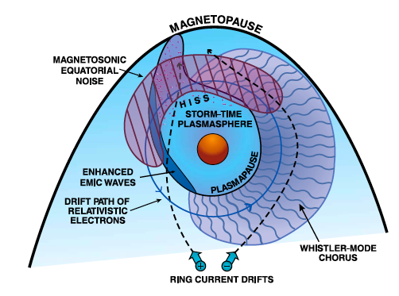
Changes in electron flux
Flux decreases can be attributed to adiabatic effects or real losses (precipitation or magnetopause shadowing)
Largest fluxes during declining phase from solar maximum
Dst effect: adiabatic decrease where ring current builds up, decreasing magnetic field strength. This leads to outward radial motion of electron drift paths.
Pitch angle scattering (precipitation)
Plasmaspheric hiss (explains
formation of slot region)
Chorus
Electromagnetic ion cyclotron
waves (near dusk)
Magnetopause losses cause flux
dropouts during the main phase
of a storm
Adapted from R. M. Thorne GRL 2010

Slide 20
Microbursts
Observing microburst precipitation gives evidence for pitch-angle scattering by chorus
Same local time distribution as chorus
Duration of bursts of precipitation about the same of chorus risers
Accounts for significant losses during main phase of a storm

